Slide 1

Introduction to the DITA architecture
ACM SIGDOC Structured Authoring Committee
Stanley Doherty, Ph.D.
SJDoherty.ACM@gmail.com
https://acm-sigdoc-structured.org/1-curriculum-resources.html
Notes:
Welcome! This is the first in a series of ACM SIGDOC workshops about structured content, content management, and instructional approaches to teaching them.

Slide 2
Agenda
Challenges to industry/academic collaboration.
What is structured content?
What are DITA topics?
What are DITA maps?
How is working in DITA different from working in
a word processor?
Demo – what does content look like in DITA?
Notes:
The audience for the presentation consists of ACM SIGDOC members, including instructors and students. No prior experience with structured content or DITA in particular is assumed. The presentation notes contain many links to free, ready-to-download ACM SIGDOC resources, so there is significantly more detail behind everything discussed in this introduction. In PowerPoint, consider viewing this presentation in "Notes Page" view in order to enable active links to these resources.

Slide 3
Who is this guy?
Education
Industry roles
- B.A. English (Merrimack)
- M.A. Linguistics (Northeastern)
- Ph.D. English (Harvard)
- Individual contributor (IC):
> TW, Information Architect,
Consulting Engineer
- Manager:
> TW manager, Director, Sr. Director
Software documentation
- Lotus Development (1987-97)
- Parametric Technologies (1997-99)
- Akamai Technologies (2012-23)
- Mathworks (2013-14)
- HPE (2017)
Teaching
- Northeastern University (TA)
- Harvard University (Teaching Fellow)
- Bentley University (Asst. Professor)
Hardware documentation
- Sun Microsystems (1999-2008)
- Verivue (2008-2012)
- SimpliVity (2015-17)
Avocations
- OASIS DITA - ACM SIGDOC
- IEEE Transactions - Boston DITA UG
- Crimson Courage - ARC of MA
- SensusFidelium.org
- ModularWriting.com
Cloud documentation
- Oracle (2017-2022)
- Google LLC (2022-2025)
Notes:
The presenter has both a background in academia and industry. Stan is chairperson for the ACM SIGDOC Structured Authoring and Content Management Committee. All the resources that we develop for the curriculum are posted to our web site https://acm-sigdoc-structured.org.
-

Slide 4
Challenges to Industry/Academic Collaboration
What are the things that we can influence?
Industry/academic engagement:
  Conferences
  Professional organizations
Curriculum-oriented resources:
  Content about structured content
  Free or low-cost tools for authoring
  Relevant learning paths and teaching plans
  Relevant sample content
Consulting and support:
  Implementation advice (free consulting)
  Industry speaker/visitor bureau (ZOOM visits)
Shared industry/academic vocabulary
Shared industry/academic review processes
Notes:
Building partnerships between academia and industry can be challenging. That said, there are some areas where committees such as ours can build bridges for the benefit of students, instructors, and industry professionals. We have the ability to make reasonable progress in some areas.

Slide 5
Challenges to Industry/Academic Collaboration
What is mostly beyond our influence?
Institutional infrastructure restrictions:
  No software downloads
  No IT support
  No discretionary budgets for tech comm pilots
The number of college programs on technical communication:
  70% reduction over the past 15 years
  Lack of tenure attenuation
Research collaboration and cross-over:
  Industry research focuses on internal-only work (not public)
  Academic research not accessible to industry people
Professional opportunities for entry-level writers:
  Few (if any) internships in technical writing
  Few (if any) college hiring budgets
AI/Markdown FUD
Notes:
There are also areas where sufficient funding, technical support, or market opportunities are lacking and outside our influence. In those areas, we hope for the best – but do not set unrealistic expectations.

Slide 6
What is structured content?
Big picture
Word processors and unstructured editors provide a unified environment for authoring and publishing individual documents.
Authoring
Publishing
MS Word
HTML Editor
Markdown Editor
Confluence
VS Code Editor
Document
HTML5
PDF
AI LLM
Support
Document
Document
Document
Notes:
Word processors such as Microsoft Word or Google gDocs are great when writers want to produce the following:
- Brief documents in a brief period of time.
- Documents that should require few, if any, content updates, reorganization, or ongoing maintenance.
- Documents authored by one writer.
- Documents with little or no content that needs to shared across the organization.
Throughout high school and college, we have been taught how to author what we call linear content in work processors. For the vast majority of documents and publications in education, authoring in a word processor does a great job.

Slide 7
What is structured content?
Big picture
Structured content depends on formal definitions for content types, content hierarchy, and semantic elements required for a valid XML, database, JSON, or DITA document. DITA documents declare that they use XML syntax and instances of a particular DTD.
<?xml version="1.0" encoding="UTF-8"?>
<!DOCTYPE concept PUBLIC "-//OASIS//DTD DITA 2.x Concept//EN" "concept.dtd">
Authoring
Structure
definitions
XML desktop editor
Text editor
DITA web editor
VS Code Editor
with DITA extension
Document
Style Guide
Document
DTDs
RelaxNG
Document
Document
Notes:
"Structured content" does not mean well organized. It has a specific meaning that is relevant to how industries develop and maintain information. In this context, "structured content" requires that there be some formal definition of a document type before we create any instance of a document type. Specification precedes authoring.
ACM SIGDOC resources at https://acm-sigdoc-structured.org:
- ACM-001: What is structured content?
GenAI prompt(s):
- "What is the difference between structured and unstructured content?"
- "What is a document type definition?"
- "How do XML documents declare which DTD they are derived from?"

Slide 8
What is structured content?
Big picture
DITA editors typically have integrated XML parsers. As we enter content in the editor, that content gets reviewed by the integrated parser. If the content complies with the DTD declared in the document, the content in valid. If the content deviates from the DTD, the parser evaluates the content as invalid and (typically) suggests corrections.
Authoring
Structure
definitions
XML desktop editor
Text editor
DITA web editor
VS Code Editor
with DITA extension
Document
Style Guide
Document
DTDs
RelaxNG
Validation/Parsing
Document
Document
Notes:
Unlike word processor documents or HTML documents in a browser, the content in a structured "type" of document is constantly evaluated against the definition of that "type."
GenAI prompt(s):
- "What does an XML parser do?"
- "What does XML validation mean?"

Slide 9
What is structured content?
Big picture
When you want to publish content, you submit it to a separate publishing engine (processor). Because the DITA editor and the DITA processor validate against the same DTDs, the content is validated for a second time before it is published. A thousand DITA concept topics will have the same structure.
Authoring
Publishing
Structure
definitions
XML desktop editor
Text editor
DITA web editor
VS Code Editor
with DITA extension
Document
Validation
HTML5
PDF
AI LLM
Support KB
Style Guide
Document
DTDs
RelaxNG
Validation/Parsing
Validation
Document
Validation
Document
Validation
Notes:
Valid structured content is predictable, consistent, automation-ready, and easy to process at scale (millions of documents). XML focuses on describing content and leaves generating the presentation style to processors. One XML document can produce many different output styles and formats.
ACM SIGDOC resources at https://acm-sigdoc-structured.org:
- ACM-031: How do I publish DITA content using the DITA Open Toolkit?
GenAI prompt(s):
- "How does XML separate content from formatting?"

Slide 10
What is structured content?
Big picture
Valid structured content is consistent, making it ideal for automated style checking, content management, build processing, AI ingestion, and dynamic delivery. The same validation and automation that works for 20 topics, scales for 1,000,000.
Authoring
Automation
Publishing
Structure
definitions
XML desktop editor
Text editor
DITA web editor
VS Code Editor
with DITA extension
Document
DITA-OT
Schematron
Vale
Build gates
HTML5
PDF
AI LLM
Support KB
Style Guide
Document
DTDs
RelaxNG
Validation/Parsing
Document
Document
Notes:
Achieving "scalability" is a big deal. Without document type definitions to govern any instance of a structured document, minor variations in its structure creep into documents. Generated PDFs or HTML pages betray variations and errors.
Automation tools such as DITA Open Toolkit build processors, Schematron compliance checkers, and GitHub build gates ensure that each instance of a type of document conforms to its type definition. This allows millions of documents to be processed with high confidence that the content is valid, correct, and ready to be integrated with company publishing portals. Structured content does add overhead. The payoff is the scalability that comes with automation.
GenAI prompt(s):
- "What is Schematron and what does it do?"
- "What do GitHub build gates do?"
- "What does continuous integration (CI) mean?"
- "How does structured content support continuous integration?"

Slide 11
What are DITA topics?
A DITA topic is the basic, modular unit of authoring, consisting of a self-contained
XML file focusing on one subject. It typically includes a title and content, categorized by
type — usually concept, task, or reference — to ensure consistency and maximize reuse
across different publications.
Out-of-the-box DITA 2.0 supports six popular topic types.
Type Answers DTD
Concept What is this? concept.dtd
Task How do I use this? task.dtd
Reference What are the details? reference.dtd
General TBD topic.dtd
Troubleshooting How do I fix this? troubleshooting.dtd
Glossary What terms are relevant? glossaryentry.dtd
NOTE: Any of these OOTB topic types can be specialized.
Notes:
ACM SIGDOC resources at https://acm-sigdoc-structured.org:
- ACM-016: What are DITA topics?
- ACM-010: DITA Information Types Aren’t Templates: They Map Content to How the Human Brain Works
GenAI prompt(s):
- "What is modular writing?"
- "How does information typing improve content quality?"

Slide 12
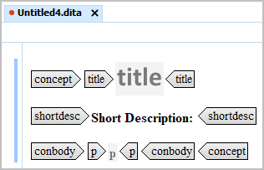
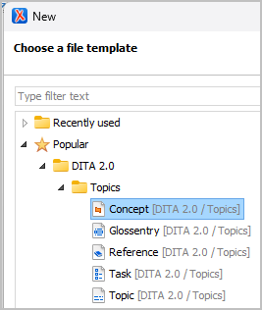
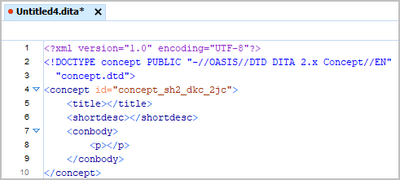
What are DITA topics?
Creating a particular type of DITA topic is easy in a DITA editor.
View in
“tags” mode
View in
“text” mode
Notes:
There are free and inexpensive DITA editors out there:
- Syncro Soft Oxygen Editor (commercial, academic discount and 30-day evals available)
- XMLMind Personal Edition (free)
- Microsoft VS Code with the DitaCraft extension (free)
ACM SIGDOC resources at https://acm-sigdoc-structured.org:
- ACM-014: XMLmind Editor Quickstart: How do I create, assemble, and build my first DITA publication?
- ACM-032: QuickStart: DitaCraft and Visual Studio Code
- ACM-006: Oxygen Editor Quickstart: How do I create, assemble, and build my first DITA publication in Syncro Soft Oxygen Editor?
GenAI prompt(s):
- "What is a DITA editor and what does it do?"
- "How do I create DITA topics in a DITA editor?"

Slide 13
What are DITA topics?
All DITA markup is XML and consists of:
XML elements: <xref>, <note>
XML attributes: <xref href="topic1.dita"/>
<note type="caution">
XML attribute values: <xref href="topic1.dita"/>
<note type="caution">
HTML-style comments: <!– This is a comment -->
Notes:
GenAI prompt(s):
- "What is XML syntax for elements, attributes, and attribute values?"
- "How is XML syntax different from HTML5 syntax?"

Slide 14
What are DITA topics?
All DITA topics require a few elements in the same order.
XML declaration
<?xml version="1.0" encoding="UTF-8"?>
<!DOCTYPE concept PUBLIC "-//OASIS//DTD DITA 2.x
Concept//EN" "concept.dtd">
<concept id="concept_sh2_dkc_2jc">
<title></title>
. . .
. . .
. . .
. . .
. . .
. . .
. . .
. . .
. . .
. . .
. . .
. . .
. . .
. . .
. . .
. . .
. . .
</concept>
DTD declaration
Root element with ID
Topic title
Notes:
All DITA topics require four elements. Everything else is optional.

Slide 15
What are DITA topics?
All DITA topics offer optional elements in the same order.
<?xml version="1.0" encoding="UTF-8"?>
<!DOCTYPE concept PUBLIC "-//OASIS//DTD DITA 2.x
Concept//EN" "concept.dtd">
<concept id="concept_sh2_dkc_2jc">
<title></title>
<shortdesc></shortdesc>
<prolog>
<metadata>
<prodinfo>
<prodname></prodname>
</prodinfo>
</metadata>
</prolog>
<conbody>
<p></p>
</conbody>
<related-links>
<link href="topic1.dita"/>
</related-links>
</concept>
Short description
Prolog with metadata
Topic body container
Related links
Notes:
In addition to the four required elements, all DITA topics support the same four optional elements in the same order.
GenAI prompt(s):
- "What elements are required in all DITA topic types?"
- "Which optional elements are shared by all DITA topic types?"
- "Which elements are unique to the DITA strict task topic type?"
- "Which elements are unique to the DITA glossentry topic type?"
- "Which elements are unique to the DITA troubleshooting topic type?"

Slide 16
What are DITA topics?
Writers use the same 16 body elements most frequently (95%)
<p> (Paragraphs)
<section> (Organizing body content)
<ul> (Unordered lists)
<li> (List items)
<xref> (Cross-references)
<image> (Graphics and screenshots)
<table> (Structured tabular data)
<entry> (Table cell)
<row> (Table row)
<fig> (Figure wrapper)
<note> (Warnings, tips, notices)
<codeph> (Inline code phrase)
<ph> (Generic inline phrase)
<keyword> (Semantic keyword markup)
<cmd> (Task step command)
<step> (Task procedure step)
<steps> (Container for task steps)
Notes:
Many of these most-frequently-used elements in DITA are, by design, derived from HTML5 elements. If you had experience writing HTML code for the web, you already know the important DITA elements.
If you have HTML5 files available, consider asking your DITA editor to import and convert them to DITA generic topics.

Slide 17
What are DITA topics?
Semantic markup is everywhere! The name of the element
describes its content. Great for AI ingestion engines.
Block elements
Phrase elements
<shortdesc>
<prereq>
<context>
<steps>
<cmd>
<codeblock>
<stepresult>
<result>
<postreq>
<msgblock>
<syntaxdiagram>
<systemoutput>
<audio>
<video>
<cite>
<codeph>
<cmdname>
<menucascade>
<uicontrol>
<filepath>
<msgph>
<userinput>
<apiname>
<equation-inline>
<partno>
Notes:
The out-of-the-box elements in the DITA standard evolved in response to requests from hardware, software, and API writers. If there were significant requests for a new element, the OASIS DITA Technical Committee would evaluate the request and, if approved, add the new element to the next release of the standard. In almost all recent cases, these requests were for a new semantic element, that is – some element name that described the meaning (semantics) of its content.
When a DITA processor encounters a block element, it creates space (a break) above and below the content of that block. It creates no break for phrase (inline) elements.
ACM SIGDOC resources at https://acm-sigdoc-structured.org:
- ACM-002: What is semantic markup?

Slide 18
What are DITA topics?
DITA is optimized for content reuse-by-reference, not copying.
Any element with a unique @id attribute value can be referenced by other elements.
Source markup with @ids
<ph id="ph_product1">Product name #1</ph>
<section id="section_new-restrictions">. . .</section>
<fig id="fig_network-topography">. . . </fig>
<codeblock id="codeblock_python-create-object">. . . </codeblock>
Content references
<p>Buy <ph conref="lib.dita#lib-id/ph_product1"/></p>
<section conref="lib.dita#lib-id/section_new-restrictions"/>
<fig conref="lib.dita#lib-id/fig_network-topography"/>
<codeblock conref="lib.dita#lib-id/codeblock_python-create-object"/>
Notes:
If I want the same content to appear in multiple Google gDocs, I need to copy that shared content into each gDoc. Zero reuse.
In MS Word, I have options for creating a library of reusable snippets that can be referenced into multiple MS Word docs. It's tricky, but works at the phrase or small block level. Reusing MS Word documents or large sections of a document across multiple publications requires heroics and a high pain threshold.
XML and DITA were designed from Day-1 to identify reusable content and then to reference it from most any other topic. The @id attribute serves as the identifier for reusable elements. The @conref and @conkeyrefs attributes serve as the mechanisms to reference that reusable content.
ACM SIGDOC resources at https://acm-sigdoc-structured.org:
- ACM-013: How does OASIS DITA support content reuse?
- ACM-027: How do I manage reusable text resources in DITA using direct references?
- ACM-028: How do I manage reusable text resources in DITA using indirect, key-based references?
GenAI prompt(s):
- "How does DITA promote content reuse"?

Slide 19
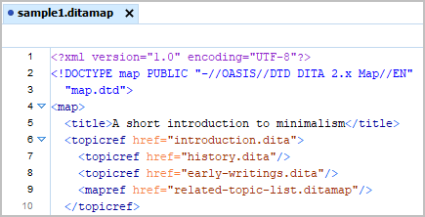
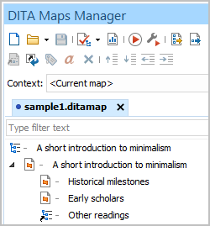
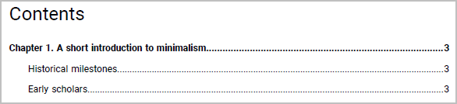
What are DITA maps?
DITA maps are XML documents that reference subordinate topics, maps, and resources. Topics provide content for a publication;
maps provide the "logic" – topic sequence, hierarchy, metadata, and publication-related information.
When viewed as text . . .
When viewed in a DITA editor . . .
When processed into a PDF . . .
Notes:
DITA maps provide the engine for topic-based authoring, modular reuse, single-source publishing, and key-based referencing.
GenAI prompt(s):
- "What is a DITA map?"
- "How do I define keys in a DITA map?"
- "Why are key references preferable to hard-coded references?"
- "Generate a DITA 2.0 map that references a DITA generic topic, task topic, concept topic, and reference topic."

Slide 20
What is the DITA architecture?
Maps provide logic and
reference child topics
Topics focus on specific info
types
Topics have similar structures
Topics support semantic markup
Topics support content reuse
rootmap.ditamap
task_install.dita
concept_configure.dita
ref_ux-tour.dita
lib_shared-blocks.dita
Notes:
Not rocket science. At a document level, the DITA architecture consists of maps, content topics, and reuse libraries.

Slide 21
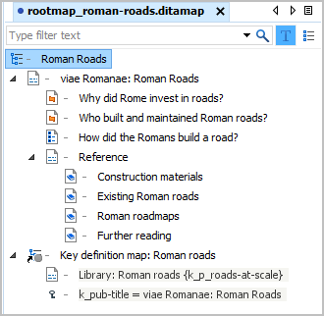
What is the DITA architecture?
Maps provide logic and
reference child topics
Topics focus on specific info
types
Topics have similar structures
Topics support semantic markup
Topics support content reuse
rootmap.ditamap
task_install.dita
concept_configure.dita
ref_ux-tour.dita
lib_shared-blocks.dita
Notes:
After a few days, working in maps, topics, and libraries becomes logical.

Slide 22
How is working in DITA different from working in a word processor (Word, GDoc)?
Feature | Word processor | DITA (OOTB)
Overhead | Low | Moderate
Authoring app | WP app | DITA editor
Review app | WP app | GitHub / Web review
Publishing app | WP app | DITA Open Toolkit
Artifact(s) | One document | Multiple topics and maps
Document format | Proprietary Binary | Open standard Text
On-screen styling | WYSIWYG | Not WYSIWYG Suggestive, not real
Content styling | Integrated CSS | Separate processor transforms
Notes:
Moving to out-of-the-box DITA from a word processor is less challenging than you might think – as long as you adjust your expectations.
GenAI prompt(s):
- "How does writing in DITA differ from writing in a word processor?"
- "What is the difference between linear and modular documentation?"

Slide 23
How is working in DITA different from working in a word processor (Word, GDoc)?
Feature | Word processor | DITA (OOTB)
Content ownership | 1 writer | 1+ writer(s)
Images/multimedia | Embedded | Referenced
Build automation | Limited | Robust
Engineering integration | Limited | Robust
Version control | One document One control thread | Multiple documents Multiple threads
Content reuse | Copying | By reference
Cross-document linking | Limited | Robust
Semantic markup | Limited | Robust
Real-time validation | None | Robust
Enterprise scalability | None | Robust

Slide 24
Options to get started
If you have little or no exposure
to DITA . . .
If you have campus IT support
for GitHub . . .
If students have access to VS Code
and can download apps . . .
If you have no $$ and can
download applications . . .
If you have no $$ and need a
solution for < 30 days . . .
Review the ACM SIGDOC resources
on “Structured Authoring” website.
See Dr. Carlos Evia’s GitHub Actions
plug-ins.
Download the DitaCraft extension
and DITA-OT.
Download VS Code, DITA-OT,
DitaCraft, or XML Mind.
Download the Oxygen Editor 30-day
evaluation license.

Slide 25
DEMO – DEMO - DEMO
No-cost options
DITA authoring in a text editor + the DITA-OT.
DITA authoring in XMLMind + the DITA-OT.
DITA authoring in VS Code + DitaCraft extension + the DITA-OT.
DITA authoring in 30-day Oxygen Editor license.
DITA authoring in Heretto CCMS web instance (ACM SIGDOC pilot).
Low-cost options
DITA authoring in academic Oxygen Editor license (starting at $72).

Slide 26
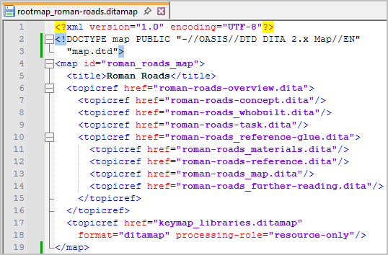
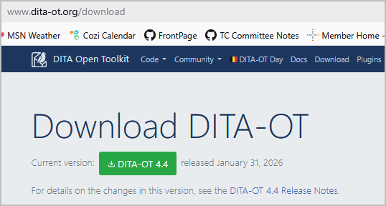
Text editor + DITA-OT
Command window/shell
C:\>..\dita-ot-4.4\bin\dita \
-i "C:\roman_roads_dita\rootmap_roman-roads.ditamap" \
-f pdf \
-o intro-roman-roads
NOTE: DITA tools run on Windows, Mac, and Linux.
Notes:
Plain text editors have no built-in XML parser. As you enter DITA markup, the text editor cannot identify where the markup is not well-formed syntactically or invalid relative to a DTD.
When working in a plain text editor, consider downloading and installing the free, open-source DITA Open Toolkit. While you edit content in one window, you can submit your DITA map to the DITA Open Toolkit in a separate window. The DITA Open Toolkit supports an XML parser, so it reports any errors that may be in your working markup. The various stylesheets in the DITA Open Toolkit allow you to publish the same content (map) to multiple output formats, such as HTML5, PDF, or Markdown.

Slide 27
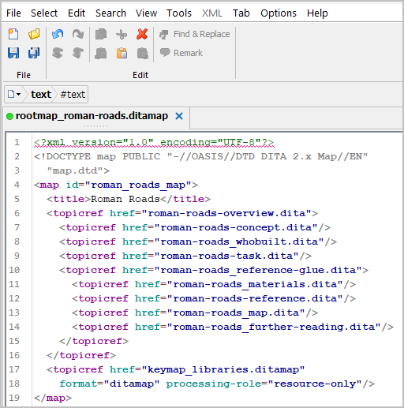
XMLMind editor + DITA-OT
Command window/shell
C:\>..\dita-ot-4.4\bin\dita \
-i "C:\roman_roads_dita\rootmap_roman-roads.ditamap" \
-f pdf \
-o intro-roman-roads
Notes:
The XMLMind Personal Edition Editor is free, cross-platform (Windows, Mac), and usable.
When working in the Personal Edition of XMLMind, there is no integrated XML parser. Consider downloading and installing the free, open-source DITA Open Toolkit. While you edit content in XMLMind, you can submit your DITA map to the DITA Open Toolkit in a separate window. The DITA Open Toolkit supports an XML parser, so it reports any errors that may be in your working markup. The various stylesheets in the DITA Open Toolkit allow you to publish the same content (map) to multiple output formats, such as HTML5, PDF, or Markdown.
ACM SIGDOC resources at https://acm-sigdoc-structured.org:
- ACM-014: XMLmind Editor Quickstart: How do I create, assemble, and build my first DITA publication?

Slide 28
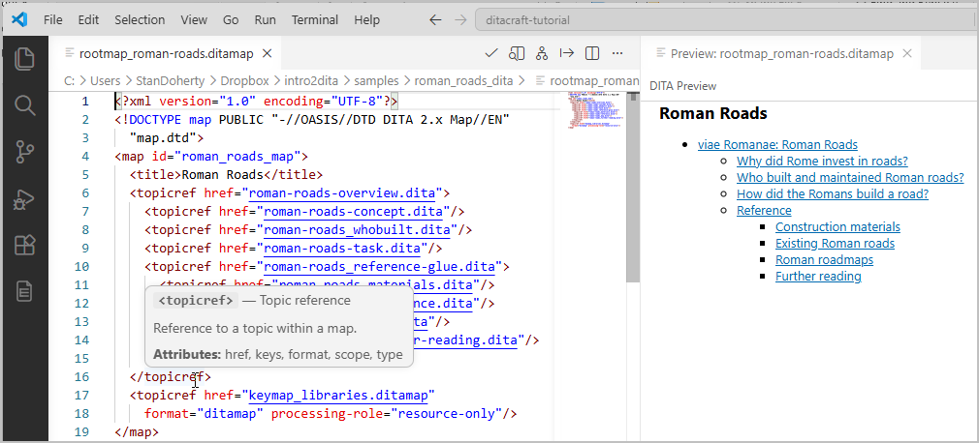
VS Code + DitaCraft extension + DITA-OT
Notes:
Many college-level computer science departments ask their students to download and install the free Microsoft Visual Studio Code editor. The default editor knows nothing about XML or DITA, so you need to install a free VS Code extension called DitaCraft Extension. This extension enables basic DITA editing capabilities for anyone using VS Code.
ACM SIGDOC resources at https://acm-sigdoc-structured.org:
-ACM-032: QuickStart: DitaCraft and Visual Studio Code

Slide 29
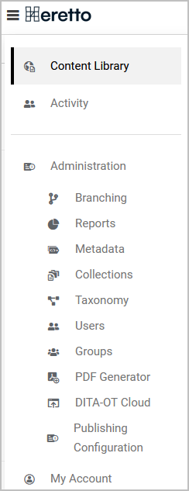
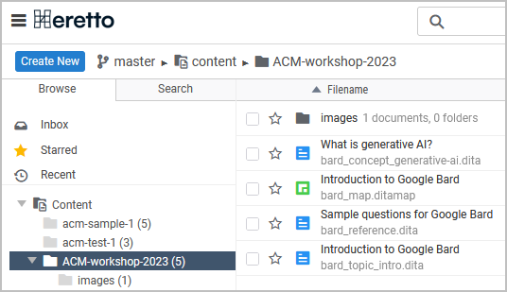
Heretto web CCMS
Notes:
ACM SIGDOC resources at https://acm-sigdoc-structured.org:
- ACM-005: Heretto Quickstart: How do I create, assemble, and build my first DITA publication in the Heretto CCMS?
- ACM-024: What is a Component Content Management System (CCMS)?

Slide 30
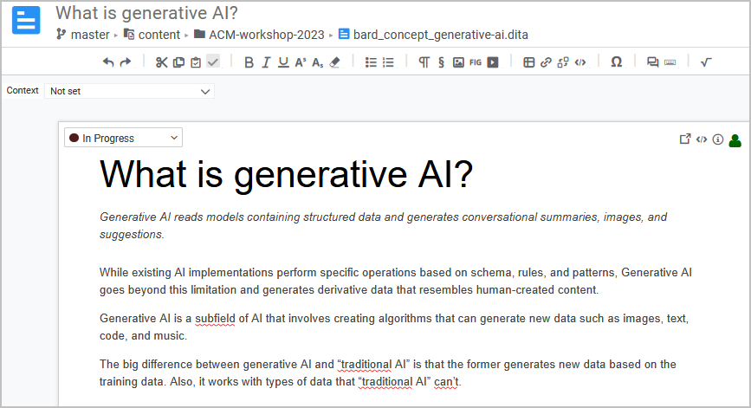
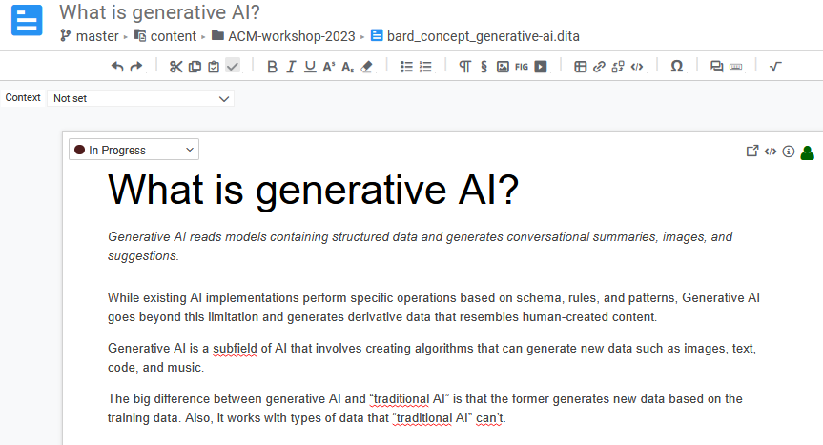
Heretto web CCMS
Notes:
GenAI prompt(s):
- "What is a component content management system?"
- "What are the important features in a component content management system?"

Slide 31
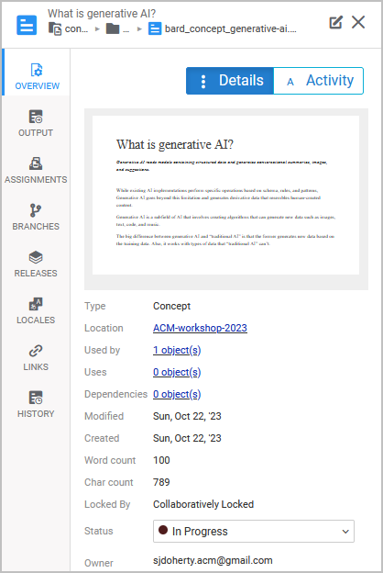
Heretto web CCMS

Slide 32
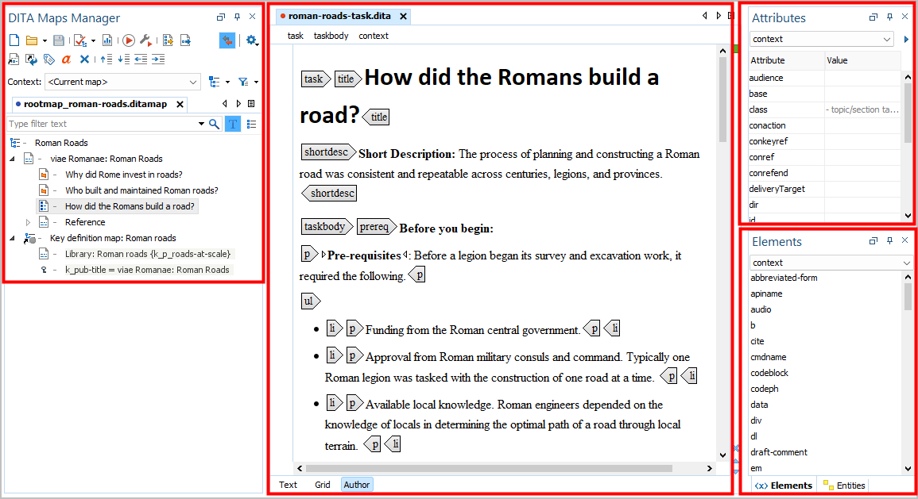
Oxygen Editor
Notes:
The Syncro Soft Oxygen Editor is a full-featured, commercial DITA editor that is quite popular in the industry. Academic discounts are available. From the perspective of learning about DITA, the Oxygen Editor provides extensive documentation about DITA and extensive in-app user assistance. The Oxygen Editor User Guide sources are posted to GitHub.
ACM SIGDOC resources at https://acm-sigdoc-structured.org:
- ACM-014: XMLmind Editor Quickstart: How do I create, assemble, and build my first DITA publication?
- ACM-007: Configuring Oxygen Editor

Slide 33

Oxygen Editor

Slide 34
Upcoming ACM SIGDOC workshops
06-12-2026
Introduction to Component Content Management
Keith Schengili-Roberts
This hour-long workshop aims to provide students with an understanding of
how a modern Component Content Management System (CCMS) is used.
Keith will not only show the basics of how a technical writer would use the system
by working and publishing DITA XML-based content, but also look at some of the
administrative functions of the system.
- What is a Component Content Management System (CCMS)?
- What is the typical technical infrastructure for a cloud-based CCMS?
- How do technical writers work with and author content within a CCMS?
- What are roles and groups within a CCMS?
- How does a manager come up with production metrics within a CCMS?
TBD-2026
Hands-on workshop: Authoring in DITA
Stan Doherty
TBD-2026
Using Committee resources to develop teaching
plans for DITA
TBD
Notes:
Stay tuned for other workshops on structured authoring, content management, and relevant teaching plans.

Slide 35
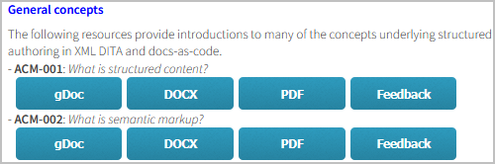
Follow-up for ACM SIGDOC
Please review the resources that the Structured Authoring
committee has developed thus far.
https://acm-sigdoc-structured.org/1-curriculum-resources.html
Email me to get a copy of these slides.
SJDoherty.ACM@gmail.com
Contact our Steering Committee to learn more about our work or
to organize a Fall/2026 semester pilot.
Steering-Committee@acm-sigdoc-structured.org
Be well.
Notes:
Please stay in touch and, if possible, get involved.

Slide 36

